Slide 1

Allie Project – IT Team up
Java Essential 3
2016
Joe Liu

Slide 2
Goal
Understand class, abstract class, interface
Understand encapsulation, inheritance, polymorphism
Understand OOP principle: SOLID
Notes:
這一堂的解釋都會比較抽象一點 大家可以發揮想像力 希望大家認真快樂上課~

Slide 3

Blue Print
Let’s look at 3 blue print types in Java

Slide 4
blue print for a object – class
Usage: we want to design a concrete thing that has certain properties, behavior.
For example, we can design classes: Teacher, Student, Course
In Java, you can use class to this purpose.

Slide 5
Blue print for generic term – abstract class - 1
Usage: we want to design the general concept of a group of things, and leave some concrete factors for subclass to implement.
For example, we can design a class: Bird with a concept: with 2 wings, 2 legs; then follow this concept, we design more concrete subclass: Eagle, Swallow, Goose.
In Java, you can use abstract class to this purpose. A abstract class can’t be created as new instance as it has abstract methods.

Slide 6
Blue print for generic term – abstract class - 2
A abstract class can be extended by other class. The subclass need to override the abstract method in abstract class

Slide 7
blue print – Bird and its sub-classes
public abstract class Bird {
int leg = 2;
int wing =2;
abstract void sign();
}
public class Swallow extends Bird {
//必須實作abstract method
//void sign() {
//System.out.println("ssss");
//}
}
public class Eagle extends Bird {
//必須實作abstract method
//void sign() {
//System.out.println("eeee");
//}
}
public class Goose extends Bird {
//必須實作abstract method
//void sign() {
//System.out.println("ggggg");
//}
}
abstract class: 抽象類別, abstract method: 抽象方法, 都需要在宣告中冠上abstract
一個抽象方法沒有程式區塊, 只有宣告
一個抽象類別不一定要宣告一個抽象方法, 但是一個類別有抽象方法一定是抽象類別
一個抽象類別有宣告抽象方法時, 子類別繼承它的時候, 一定要實作抽象方法

Slide 8
Skill blue print – interface - 1
Usage: we want to design a general ability which doesn’t belong to any class.
For example, an ability: flyable to open to any class. A class: Fish originally doesn’t has this ability, but if we want, we could design a subclass FlyFish extends from Fish and implement Flyable. If we want, FlyFish could also implement Walkable.
In Java, you can use interface to this purpose. A class can implement many interfaces. A interface can extend from other interfaces.

Slide 9
Skill blue print – interface - 2
Interface ( in Java and in word) is the communication channel and protocol we can see from outside. The member in the interface has below feature in default:
Variable:
Public: open for outside
Static: as interface is the deal, it doesn’t want to change
Final: as above
Method:
Public: open for outside
Abstract: only declaration, no implementation

Slide 10
Skill blue print – interface - 3
When a class implement a interface, it must override the interface’s method
If name conflict is happen in multiple interface implementation. For example, class A implement interface B and C. Both interface B and C have the same variables and methods.
Variable: as it has static feature: belong to class, not object. You need to add class name in front of variable.
Method: you only need to implement the method once.

Slide 11
blue print – FlyFish
public class FlyFish extends Fish implements Flyable, Walkable {
public void walk() {
}
public void fly() {
}
void swim() {
}
}
public interface Flyable {
void fly();
}
public interface Walkable {
void walk();
}
public abstract class Fish {
abstract void swim();
}
介面 (interface)在宣告中冠上interface
注意雖然在介面中沒有定義方法的修飾子, 但是在子類別中都加上了public. 這是必須的, 因為方法在interface中預定是public的

Slide 12
blue print – InterfaceTester
public class Bird implements IFlyable {
public void fly() {
}
}
public class FlyFish extends Fish implements IFlyable{
public void fly() {
}
}
public class InterfaceTester {
void flyBy(IFlyable flyThing) {
flyThing.fly();
}
public static void main(String[] args) {
InterfaceTester ift = new InterfaceTester();
//凡是繼承IFlyable的子類別實體皆可以傳入
ift.flyBy(new FlyFish());
ift.flyBy(new Bird());
}
}
介面一如父類別一樣, 宣告類型為父類時, 在給值的時候可以接收子類別實體

Slide 13
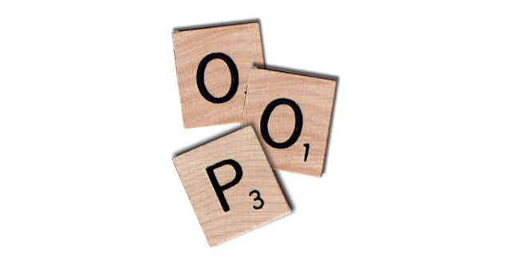
J
A
V
A
Encapsulation => Inheritance => Polymorphism

Slide 14
Encapsulation
The goal to encapsulation is modularize your code and make relationship between each module to the lowest. In this way, we can avoid “a small change affects everything”.
Hope to lower the complex of code and easy developing and maintains.
To do this, Java provide package, class and visibility setting(modifier).

Slide 15
Inheritance
Inheritance allows a class to use the properties and methods of another class. The subclass can add its own additional variables and methods or modify inherited variables and methods.
The superclass and subclass have “is-a” relationship between them.
Make modifier as private in variables or methods , to avoid those to be inherited.
Make final in class declaration, this class can’t be extended.

Slide 16
The way of reuse
To reuse the code, there are two design technique: inheritance and composition
Inheritance is reuse code from superclass. When two class relation is more like “is-a”, you should use inheritance .
Composition is reuse the code from instance variables that refers to other objects. When two class relation is more like “has-a”, you should use composition .

Slide 17
Composition example - 1
A example for bad use case of inheritance
C
天下武功百百種…Boxer類別內不該實作功夫
BoxerLeftHand
void attack() {
//左鉤拳
}
C
C
Boxer
BoxerTurbo
void attack() {
//右鉤拳
}
// other members …
void attack() {
//右昇龍拳
}
C
BoxerLeftHandTurbo
void attack() {
//左昇龍拳
}
․
․
․

Slide 18
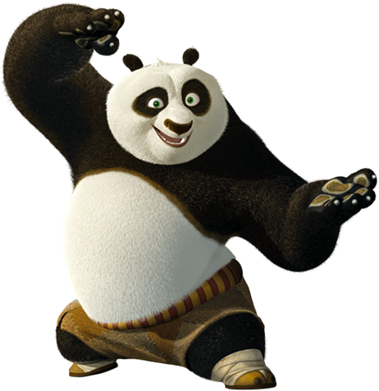
Composition example - 2
Move to composition …
C
RightHook
C
void attack()
Boxer
IKongFu fk;
Boxer(IKongFu fk) {
this.fk = fk
}
void fight() {
fk.attack();
}
// other members …
C
LeftHook
I
void attack()
IKongFu
void attack()
C
RightShouryuken
C
void attack()
Panda
IKongFu fk;
Boxer(IKongFu fk) {
this.fk = fk
}
void fight() {
fk.attack();
}
// other members …
C
LeftShouryuken
void attack()

Slide 19
Up casting and down casting
The object reference type can up cast to superclass or down cast to subclass. Up casting always works in Java, you can reference to Dog class example in essential2. Down casting might run into error if the result class is not the instance’s class or superclass.
Husky husky = new Husky();
Chihuahua chihuahua = new Chihuahua();
//向上轉型, 一定都合法
Dog dog = husky;
//向下轉型, 使用()來放轉型後的class name, 這是合法的例子
husky = (Husky)dog;
//向下轉型, 這是不合法的例子, 編譯不會檢查, 執行會出錯
chihuahua = (Chihuahua)dog;

Slide 20



Essential 2
This is a dog?
Let’s say we have a class: Dog, and it’s sub-class: Husky, Chihuahua …
We can do this in Java.
We can’t do this in Java.
A Husky, Chihuahua must be a Dog;
But a Dog might not be a Husky, Chihuahua.
Dog laiFu = new Husky();
Dog laiOne = new Chihuahua();
Husky laiFu2 = new Dog();
Chihuahua laiOne2 = new Dog();
狗

Slide 21
Type checking
Sometimes you might need to do down casting, but the possible subclass can be multiple. You can do type checking for those subclasses.
Husky husky = new Husky();
Dog dog = husky;
if(dog instanceof Husky) {
husky = (Husky)dog;
} else if (dog instanceof Chihuahua) {
chihuahua = (Chihuahua)dog;
}
要注意的是dog的參考型態是Dog, 而instanceof後面能夠接的只有Dog的子類別: Husky, Chihuahua, 而不是所有類別皆可放入檢查

Slide 22
Generic *
In a nutshell, generics enable types (classes and interfaces) to be parameters when defining classes, interfaces and methods. Much like the more familiar formal parameters used in method declarations, type parameters provide a way for you to re-use the same code with different inputs. The difference is that the inputs to formal parameters are values, while the inputs to type parameters are types.
* 這裡沒有展示Java泛型(Generic)的各種語法, 請自己查閱

Slide 23


Blue print - DogSellerGeneric
public class DogSellerGeneric<T extends Dog>{
T dogInHand;
void buyDog(T t) {
dogInHand = t;
}
T sellDog() {
return dogInHand;
}
}
在寫程式時, 如果你有定義泛型, IDE也會提示你這一個方法接受或回傳的類別

Slide 24
Blue print - GenericTester
public class GenericTester {
public static void main(String[] args) {
DogSellerGeneric<Husky> dsg1 = new DogSellerGeneric<Husky>();
DogSellerGeneric<Chihuahua> dsg2 = new DogSellerGeneric<Chihuahua>();
DogSellerGeneric dsg3 = new DogSellerGeneric();
//使用符合泛型宣告的類型
dsg1.buyDog(new Husky());
Husky husky1 = dsg1.sellDog();
//使用不符合泛型宣告的類型
dsg1.buyDog(new Chihuahua());
Chihuahua chihuahua = dsg1.sellDog();
//不使用泛型, 預定接受的類別是Dog
//取出時, 需要自己知道傳入的甚麼類別, 來做轉型
dsg3.buyDog(new Husky());
Husky husky2 = (Husky)dsg3.sellDog();
}
}

Slide 25
Override
Subclass modify inherited instance methods called override.
The rule* to tell if method is override or not, check a method in subclass has below condition with a method in superclass
same method name
same input parameter
same return class type (subclass of the class type is allowed)
modifier can be more open, but can’t be more closed
method in superclass can’t be private or final
* 這裡沒有提及關於exception scope的複寫條件

Slide 26
Overloading
Overloading is to give more flexible input parameter for method
You can declare a couple of methods with the same name but different input parameter in a class
Below is overloading condition:
Must with same name but different input parameter
Return type can be different in different input parameter
You can also do overloading in constructor.

Slide 27
Blue print - Overloading
public class Overloading {
public Overloading() {
}
private Overloading() {
}
private Overloading(String name) {
}
void fakeMethod(){
}
String fakeMethod(){
}
String fakeMethod(String name){
return name;
}
}

Slide 28
Polymorphism -1
Polymorphism is the capability of a method to do different things based on the object that it is acting upon.
C
Theater
A
PlayMachine
PlayMachine pm;
abstract play()
void setMachine(PlayMachine abc)
void play(Movie m);
main() {
Theater t = new Theater();
t.setMachine(new 2DPlayer);
t.play(new Movie(“Inception”));
}
C
C
C
2DPlayer
3DPlayer
IMaxPlayer
*
*
play()
play()
play()
戲院(Theater)擁有一台撥放器(PlayMachine), 透過方法設定不同的類型的撥放器, 可以變換不同撥放的形式
* Java class命名無法使用數字打頭, 這裡只是方便舉例

Slide 29
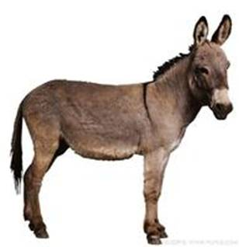
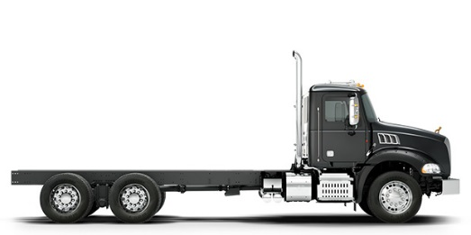
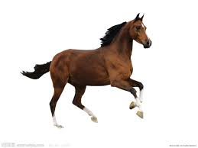
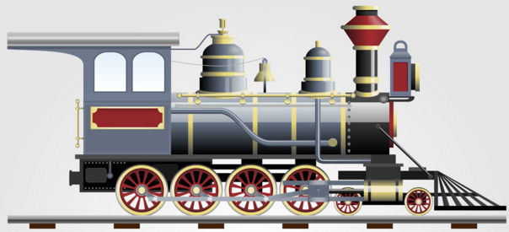

Polymorphism - 2
Use the power of interface, we can use classes from different base classes.
Animal
Car
Train
void loadCargo(ICanLoad loader)
當你使用介面:ICanLoad 來當多型的基底, 你便可以不侷限於同一種概念的物件, 只要是有實作這個介面的物件都可以使用

Slide 30

接下來的內容大部份直接轉錄自
https://nlhsueh.gitbooks.io/oose/content/manuscript/ch4OOPrinciple.html

Slide 31
Single Responsibility Principle (SRP) - 1
Every class should have a single responsibility, and that responsibility should be entirely encapsulated by the class.
Why?
The more a class does, the more likely it will change
The more a class changes, the more likely we will introduce bugs

Slide 32
Single Responsibility Principle (SRP) - 2
Cohesion and Coupling
Cohesion – How closely related are the different responsibilities of a module
Coupling – How much one module relies on another
Goal is low coupling and high cohesion

Slide 33
OCP - The Open-Closed Principle - 1
Open for extension, close for modification. We should attempt to design modules that never need to be changed.
How can we do this?
Abstraction
Polymorphism
Inheritance
Interfaces

Slide 34
OCP - The Open-Closed Principle - 2
In my option, from physical view, OCP will looks like below
….
….
iii
….
….
iii
iii跟xxx是代表修改的部分
.java
.java
….
….
xxx
xxx
xxx
.java
….
….
.java
.java
xxx
xxx
xxx

Slide 35
Liskov Subsitution Principle - 1
Functions that use references to super classes must be able to use object of subclasses without knowing it!
Why?
Unpredicted behavior between subclass will bring bugs

Slide 36
Liskov Subsitution Principle - 2
Let’s see an bad example:
Circle
C
void draw() {
}
//畫出圓形到console
A
Shape
Square
C
void draw() {
//畫出圖形到console
}
void draw() {
}
//畫出正方形到印表機
C
Triangle
void draw() {
}
//畫出三角形檔案存到硬碟

Slide 37
Interface Segregation Principle - 1
Be not cohesive/Interface pollution must be broken up into groups of methods, every group serves a different set of client
Why?
A large interface will enforce client to implement many unused method
這裡的interface泛指意義上的介面或是說基底類別, 可以是class, abstract class or interface.
Client則是指子類別.

Slide 38
Interface Segregation Principle - 2
A example for bad interface
public interface IAnimal {
void run();
void fly();
}
public class Eagle implements IAnimal {
public void run() {
// 不會跑
}
public void fly() {
// 展翅高飛
}
}
public class Dog implements IAnimal {
public void run() {
// 四腳狂跑
}
public void fly() {
// 不會飛
}
}
介面IAnimal不該定義run跟fly方法, 這些可以再出成另一個介面

Slide 39
DRY—Don’t Repeat Yourself Principle - 1
Every piece of knowledge should have a single, unambiguous, authoritative representation within a system
Why?
Things change
If you have the same thing in several places, when you change one, you have to change all the others And you can’t always find them all!
註: D在SOLID中為DI (dependency inversion), 但是這個主題太艱難, 換成常碰到又簡單的DRY

Slide 40
DRY—Don’t Repeat Yourself Principle - 2
What not to duplicate?
Data - If you represent the same data in two places (or in two ways), you have just taken on the job of keeping the two representations in agreement
Code - If you code the same task in two places (or in two ways), you have just taken on the job of keeping the two code segments in agreement

Slide 41
DRY—Don’t Repeat Yourself Principle - 3
When comes into doing the same thing as before in somewhere else, never take a shortcut (copy/paste) even if you’re in a hurry!
How to avoid copy-paste
Often the best solution is to write a method
Call the method whenever you want to perform the computation
There is nothing wrong with short methods

Slide 42

Not covered, but deserved to read
Collections API
Throw, Throws, Error, Exception
Thread
Class Reflection
Annotation

Slide 43
Homework - 1
Design a class: Student and create a TreeSet (or other java collection class) and put multiple Student instances into this TreeSet. Then code can demo below things:
Put new Student with the same studentId (String) will replace existing one
Sort Student by age (int)
Make an example code can demo 2 of below topics, and describe your code for those topics
Inheritance
Composition
Polymorphism
Interface
Abstract Class

Slide 44
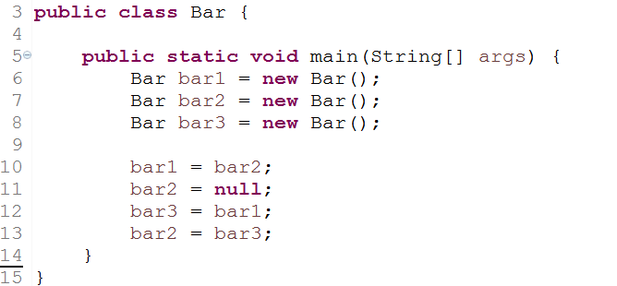
Homework - 2
Describe the object reference changes from line 10 ~ line 13.

Slide 45

Wish all the best

Slide 46
Study the real world case
The example code in lesson to explain Java concept is very simple and far away from the real world. You already got the concept from those simple case, but as to work with java in real world, learn from practical experience, best practice or other well-known framework is a good way to make yourself more professional.

Slide 47
Keep filling your Java field
Framework
Syntax, data structure, API
OOP
JVM foundation

Slide 48
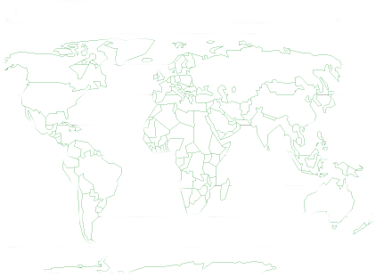

Thank You !

